Slide 1
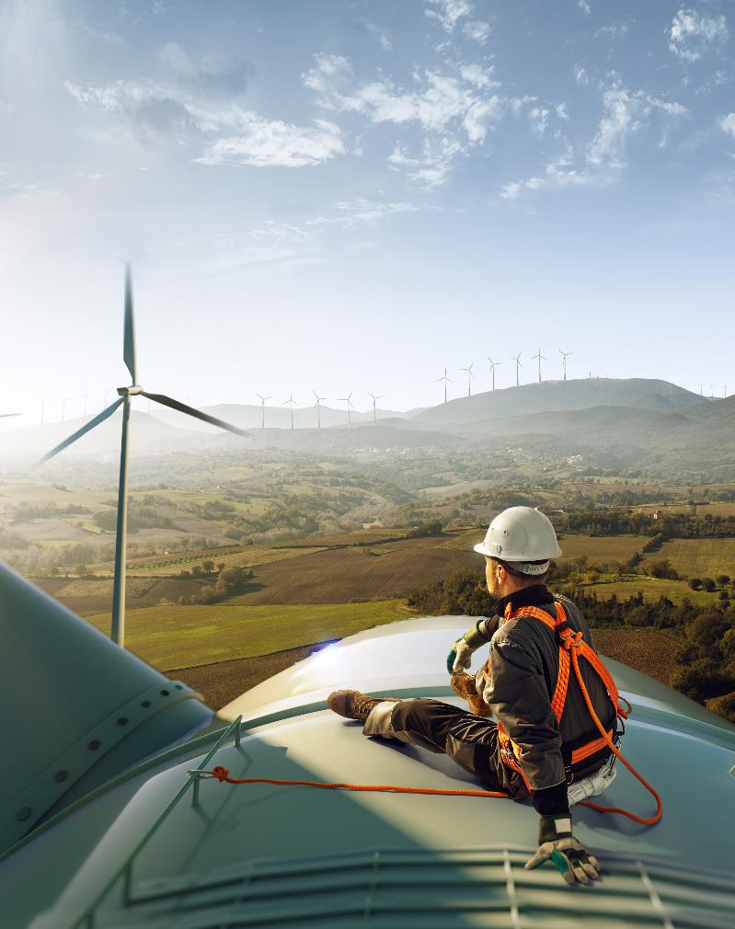
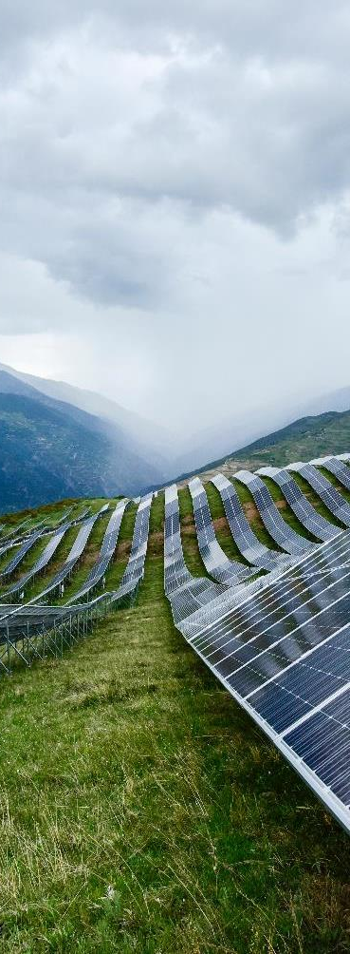
AIIB-CAREC: Investing in Renewables and Cross-Border Connectivity

Slide 2
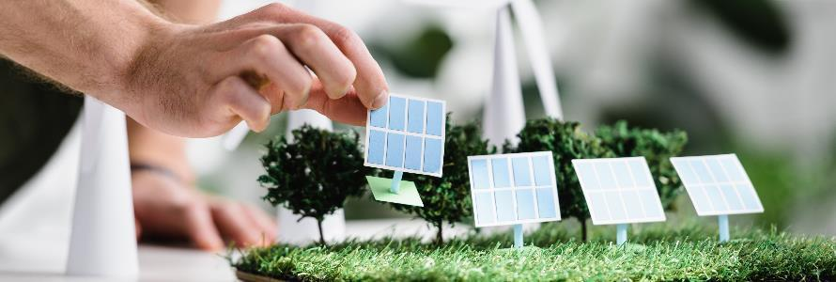
Who We Are and What We Do
We are a multilateral development bank with a mission to finance the Infrastructure for Tomorrow (I4T).
We invest in projects that meet our high international standards, as well as deliver social, environmental, and economic benefits.
Four Thematic Priorities
Green Infrastructure
Connectivity and Regional Cooperation
Private Capital Mobilization
Technology-enabled Infrastructure

Slide 3
Investing in the Infrastructure for Tomorrow AIIB’s Vision is a prosperous Asia based on sustainable economic development and regional cooperation
Cross-Border Connectivity
25-30% of actual financing approvals by 2030
Climate Financing
50% of actual financing approval by 2025
Private Sector Projects
50% of actual financing approval by 2030

Slide 4
Multilateral Cooperation Center for Development Finance (MCDF)
Multilateral initiative to increase high-quality infrastructure and connectivity investments in developing countries in compliance with International Financial Institution (IFIs) standards, including by encouraging other investors and financial institutions to adopt such standards.
It will support implementation of the G20 Quality Infrastructure Principles, the UN Agenda 2030 and its Sustainable Development Goals, as well as the Paris Climate Agreement.
The MCDF comprises of:
An MCDF Collaboration Platform to promote communication and collaboration among the IFIs and other development partners regarding plans and activities relating to infrastructure and connectivity investments;
An MCDF Finance Facility to provide grant resources to fund information sharing, capacity building and project preparation activities.
An Administrator to provide administrative and financial services to the MCDF, including the establishment and hosting of the MCDF Secretariat; and
An MCDF Secretariat to support the day to day operations of the MCDF. The Asian Infrastructure Investment Bank (AIIB) serves as the Administrator of the MCDF and host of the Secretariat with effect from June 30, 2020.
For more information visit: https://www.themcdf.org/

Slide 5
Trans Anatolian Natural Gas Pipeline (TANAP)
Client
Southern Gas Corridor Company
Project Objective
Construction and commissioning of 3,500 km of gas pipeline from Azerbaijan to Italy through Georgia, Turkey, Greece and Albania
Total Project Cost
8.6 billion USD (co-financed with World Bank, EBRD and EIB as well as BP, BOTAS and Commercial Banks)
AIIB Commitment
600 million USD (53% of total 3,500 km pipeline)
Project Link: https://www.aiib.org/en/projects/details/2016/approved/Azerbaijan-Trans-Anatolian-Natural-Gas-Pipeline-Project.html

Slide 6
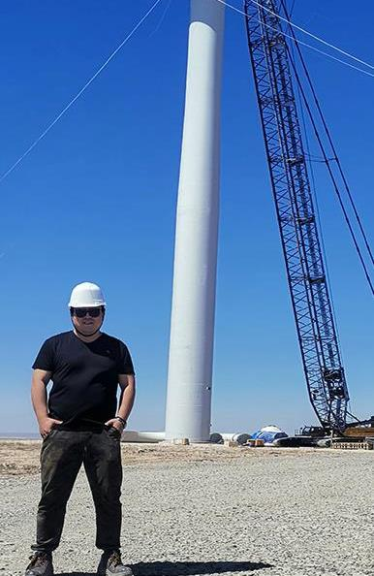
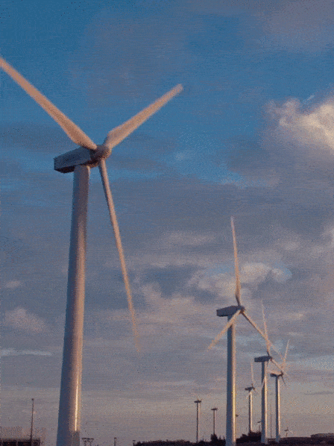
Kazakhstan - Zhanatas 100 MW Wind Power Plant
Largest Wind Farm in Central Asia
The project is to develop, construct, and operate a 100 MW wind farm in Southern Kazakhstan, approximately 9 km southwest of Zhanatas in the Zhambyl region.
AIIB is investing USD46.7 million out of the total project cost of USD136.2 million.
AIIB is the lead co-financier with support from EBRD and other financial institutions.
The project promotes the use of renewable energy, generates approximately 319 GWh per annum and avoids about 260,623 tons of carbon dioxide equivalent per year.
6

Slide 7
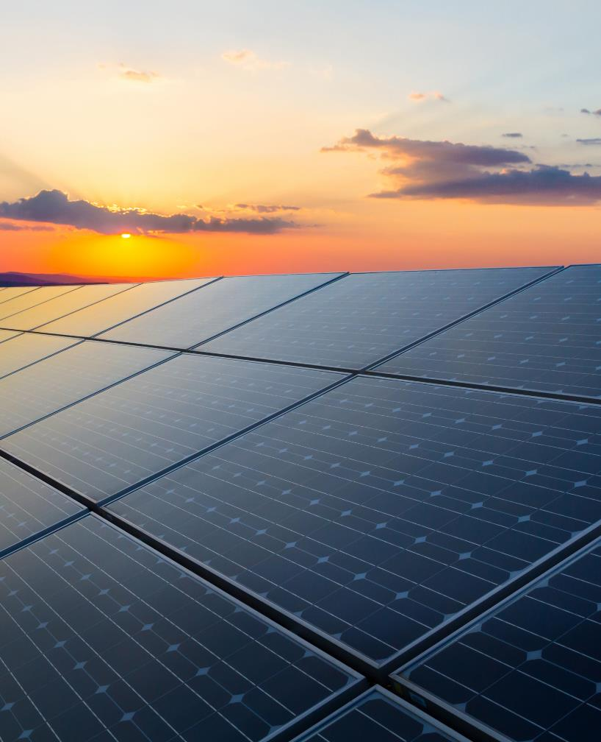
AIIB Tower A, Asia Financial Center No.1 Tianchen East Road Chaoyang District Beijing, China 100101 aiib.org

